Slide 1
Open Source Security Logging
On the cheap
(well, cheaper anyway)

Slide 2
[/home]# whoami
Scott Gerlach [sgerlach@godaddy.com, @sgerlach]
Director InfoSec Engineering and Architechture @ GoDaddy
Ran the SOC for 6 years
12yrs experience in InfoSec.
EnVision customer (Hi Tena!)

Slide 3
WHAT THIS IS
Ideas we are looking at within GoDaddy to solve our logging and scalability issues using ELK stack and Hadoop
Discussion on our experience.
Tons of reference links at the end (ask me for the preso if you want them)
Potential ramblings of a mad man

Slide 4
WHAT THIS IS NOT
Technical discussion on how to run, tune, maintain ElasticSearch
Gospel on how to run your shop
Expert training on any of these tools. I’m a n00b and I admit it but I haz a search engine!

Slide 5
WHY ELK
Cuz they’re sassy?

Slide 6
Free Open Source Software – This can also be the #1 drawback based on where management like to put boots when stuff breaks
elasticsearch - Distributed and Scalable. Multiple Compute nodes handling storage and search
Logstash – Dead easy log parsing *groking*, enrichment and outputs to make you happy. And a cool hipster logo
Kibana – Visualize your data and do it fast

Slide 7
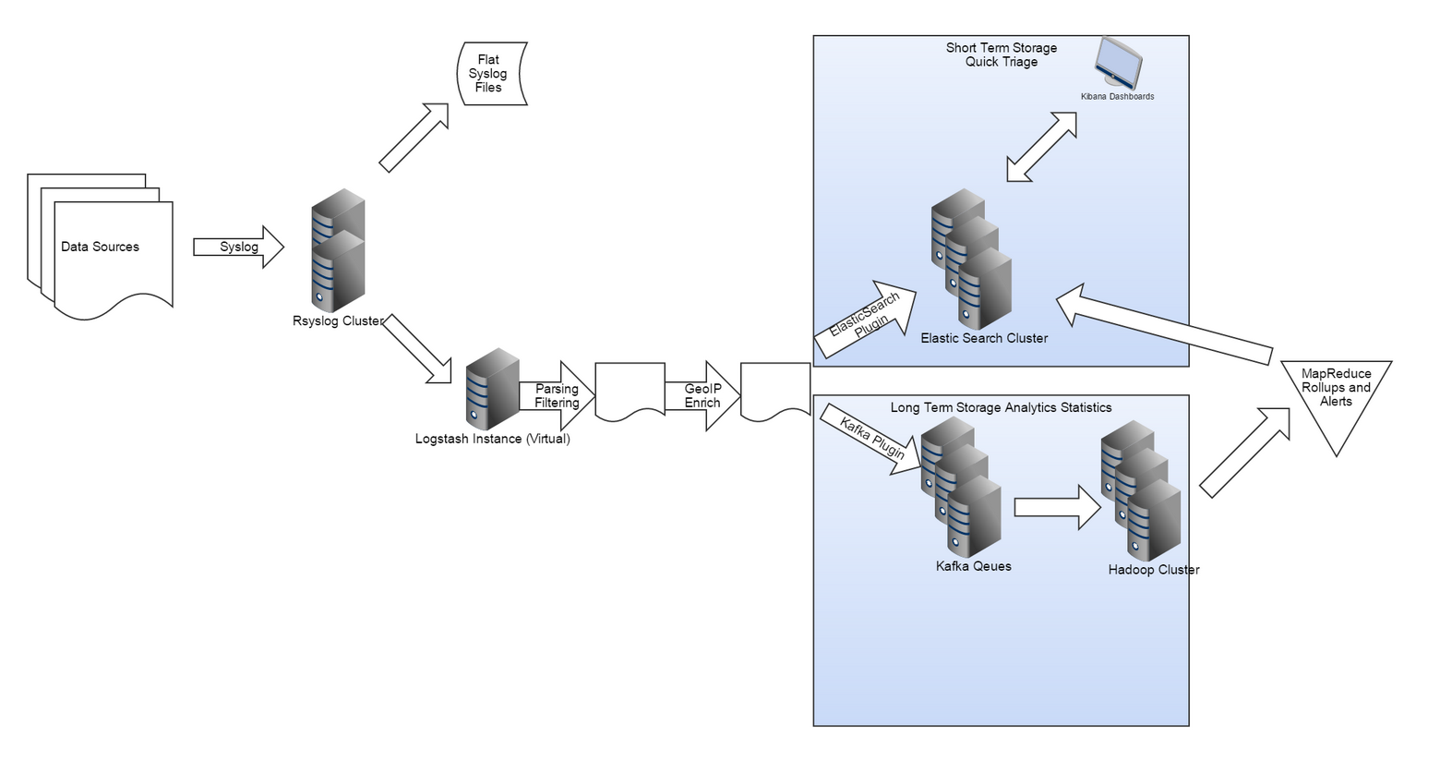
THE PLAN

Slide 8
DATA TYPES and EPS (so far)
IPS Logs – 150eps
IDS Logs – 10eps
FTP Logs – 400eps
SSHD Logs – 15eps
Customer-SSHD Logs – 30eps
Windows Executables (in house developed) – 1500eps

Slide 9
LOGSTASH & GROK
Ships with ~120 different patterns you can extend
Simple regex and data naming
%{IPORHOST:src_address} - Matches 192.168.1.1 OR euripides01
Shouldn’t need to know this
IPV4 (?<![0-9])(?:(?:25[0-5]|2[0-4][0-9]|[0-1]?[0-9]{1,2})[.](?:25[0-5]|2[0-4][0-9]|[0-1]?[0-9]{1,2})[.](?:25[0-5]|2[0-4][0-9]|[0-1]?[0-9]{1,2})[.](?:25[0-5]|2[0-4][0-9]|[0-1]?[0-9]{1,2}))(?![0-9])
IPV6 ((([0-9A-Fa-f]{1,4}:){7}([0-9A-Fa-f]{1,4}|:))|(([0-9A-Fa-f]{1,4}:){6}(:[0-9A-Fa-f]{1,4}|((25[0-5]|2[0-4]\d|1\d\d|[1-9]?\d)(\.(25[0-5]|2[0-4]\d|1\d\d|[1-9]?\d)){3})|:))|(([0-9A-Fa-f]{1,4}:){5}(((:[0-9A-Fa-f]{1,4}){1,2})|:((25[0-5]|2[0-4]\d|1\d\d|[1-9]?\d)(\.(25[0-5]|2[0-4]\d|1\d\d|[1-9]?\d)){3})|:))|(([0-9A-Fa-f]{1,4}:){4}(((:[0-9A-Fa-f]{1,4}){1,3})|((:[0-9A-Fa-f]{1,4})?:((25[0-5]|2[0-4]\d|1\d\d|[1-9]?\d)(\.(25[0-5]|2[0-4]\d|1\d\d|[1-9]?\d)){3}))|:))|(([0-9A-Fa-f]{1,4}:){3}(((:[0-9A-Fa-f]{1,4}){1,4})|((:[0-9A-Fa-f]{1,4}){0,2}:((25[0-5]|2[0-4]\d|1\d\d|[1-9]?\d)(\.(25[0-5]|2[0-4]\d|1\d\d|[1-9]?\d)){3}))|:))|(([0-9A-Fa-f]{1,4}:){2}(((:[0-9A-Fa-f]{1,4}){1,5})|((:[0-9A-Fa-f]{1,4}){0,3}:((25[0-5]|2[0-4]\d|1\d\d|[1-9]?\d)(\.(25[0-5]|2[0-4]\d|1\d\d|[1-9]?\d)){3}))|:))|(([0-9A-Fa-f]{1,4}:){1}(((:[0-9A-Fa-f]{1,4}){1,6})|((:[0-9A-Fa-f]{1,4}){0,4}:((25[0-5]|2[0-4]\d|1\d\d|[1-9]?\d)(\.(25[0-5]|2[0-4]\d|1\d\d|[1-9]?\d)){3}))|:))|(:(((:[0-9A-Fa-f]{1,4}){1,7})|((:[0-9A-Fa-f]{1,4}){0,5}:((25[0-5]|2[0-4]\d|1\d\d|[1-9]?\d)(\.(25[0-5]|2[0-4]\d|1\d\d|[1-9]?\d)){3}))|:)))(%.+)?

Slide 10
SSHD Log Sample and GROK
SSHD_AUTH <%{INT:pri}>%{SYSLOGTIMESTAMP:eventtimestamp} %{IPORHOST:dst_address} %{SYSLOGPROG:prog}\[%{INT:pid}\]: %{GREEDYDATA:action} password for %{D
ATA:user_id} from %{IPORHOST:src_address} port %{INT:src_port} ssh2
<86>Jan 6 16:07:43 a2nlswlb01 sshd[60856]: Failed password for root from 117.21.191.197 port 1243 ssh2

Slide 11
Suricata Log Sample and GROK
IDS <%{INT:pri}>%{SYSLOGTIMESTAMP:eventtimestamp} %{IPORHOST:sensor_name} %{SYSLOGPROG:prog}\[%{INT:pid}\]: \[%{INT:id}:%{INT:sid}:%{INT:rev}\] %{GREEDYDATA:filtername} \[Classification: %{GREEDYDATA:classification}\] \[Priority: %{INT:priority}\] \{%{DATA:protocol}\} %{IPORHOST:src_address}:%{INT:src
_port} -> %{IPORHOST:dst_address}:%{INT:dst_port}
<182>Jan 6 16:09:53 p3plnlids04 suricata[32600]: [1:4100009:3] Security Content - Excessive WordPress xmlrpc.php POST Requests (10/60s threshold) [Classification: Web Application Attack] [Priority: 1] {TCP} 93.174.93.61:50551 -> 173.201.1.128:80

Slide 12
Logstash Config – Input/Filter
input {
udp {
port => 51000
type => "sshd"
}
udp {
port => 51001
type => "cust-sshd"
}
udp {
port => 51002
type => "ids"
}
}
filter {
if [type] == "cust-sshd"{
grok {
patterns_dir => "/etc/logstash/grok/patterns/infosec_patterns.conf"
match => [
"message", "%{CUST_SSHD_AUTH_MULTI_FAIL}"
]
}
}
else {
drop {}
}
if ! [hit_count] {
mutate {
add_field => {
"hit_count" => 1
}
}
}
mutate {
convert => ["hit_count", "integer"]
}
geoip {
source => "src_address"
}
}

Slide 13
elasticsearch
One node.
Umm, don’t do that in prod… Data loss, performance bottlenecks, cats befriending dogs and other bad things
Our setup
3 virtual nodes – 40GB disk, 4GB RAM (not even close to what you *should* run)
3 data nodes, 1 master node, all sharing search
Handles around 100eps
Another cluster handles 2box cluster with 48Gb Ram and 4x300GB R10 Config handles ~800eps
Estimating about 1000eps in a real cluster

Slide 14
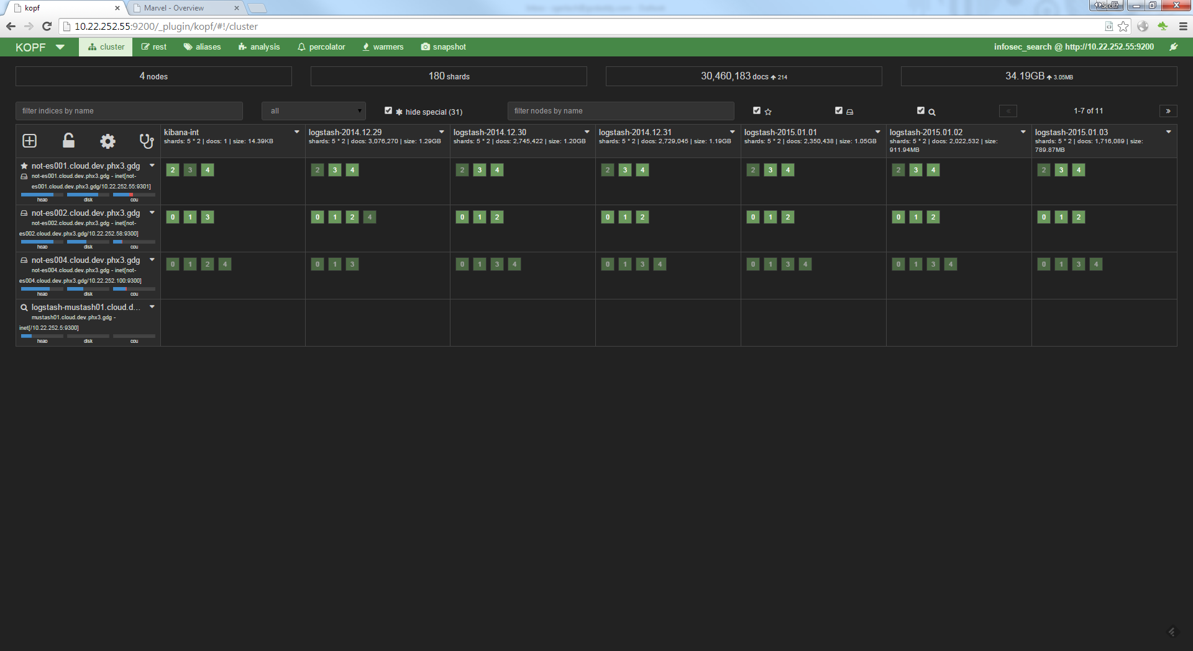
elasticsearch
One node.
Umm, don’t do that in prod… Data loss, performance bottlenecks, cats befriending dogs and other bad things
Our setup
3 virtual nodes – 40GB disk, 4GB RAM (not even close to what you *should* run)
3 data nodes, 1 master node, all sharing search
Handles around 100eps
Another cluster handles 2box cluster with 48Gb Ram and 4x300GB R10 Config handles ~800eps
Estimating about 1000eps in a real cluster

Slide 15
KIBANA

Slide 16
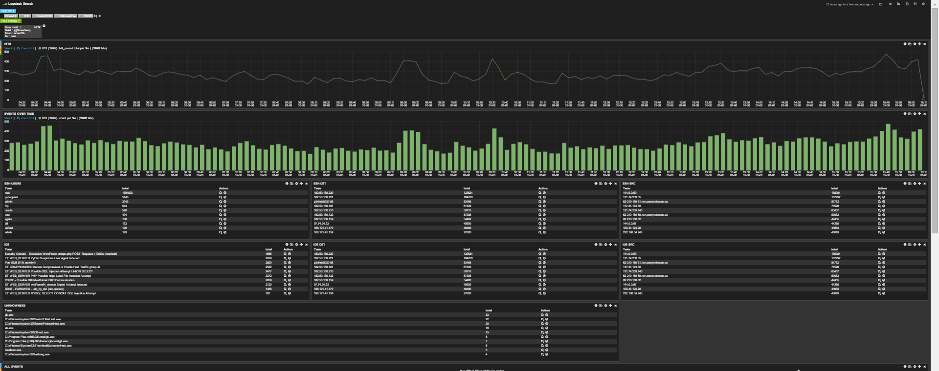
KIBANA
Pretty great out of the box
Fairly steep learning curve for more than basic tasks

Slide 17
KIBANA
LIVE DEMO
(hopefully)

Slide 18
RESOURCES
ElasticSearch
http://www.elasticsearch.org/guide
https://www.loggly.com/blog/nine-tips-configuring-elasticsearch-for-high-performance/
http://edgeofsanity.net/article/2012/12/26/elasticsearch-for-logging.html
http://www.elasticsearch.org/guide/en/elasticsearch/guide/current/_important_configuration_changes.html
Logstash
http://grokdebug.herokuapp.com/
http://logstash.net/docs/1.4.2/
Kibana
http://www.elasticsearch.org/guide/en/kibana/current/
http://www.rittmanmead.com/2014/11/analytics-with-kibana-and-elasticsearch-through-hadoop-part-3-visualising-the-data-in-kibana/

