Slide 1

Welcome
Q3 Meeting 2017

Slide 2
New Members!
Coriale Coriale
Chris Dailey
Brenda Bunch (Kopp)
PJ Schneider
Susan Snow
Leah OGrady
Brian Lajoie
Keith Swanson
Brian DeMoss
Sue Volk
Cesar Flores
Kristine E. Wetch (Albinda)
Jesse Hiatt
Lester Godsey
James Gardner

Slide 3
New Members!
Jeff Goldstein
Dan Ward
Lynn Heiberger
Jesse Reed
Ryan Murray
Kevin Walter
Chris Hahn
Cynthia Madden

Slide 4

OPEN SOURCE INTELLIGENCE TRAINING
MICHAEL BAZZELL
APRIL 27, 2017

Slide 5
OSINT Training Review
114 Attendees (95% capacity)
  Exceeded attendance goal by 44 (162% of goal!)
54 survey responses
  81% Excellent, 17% Very Good
  100% Extremely Likely or Very Likely to attend another ISSA PHX event
Close to breaking even ($18k+ revenue)
  Added perks as ticket sales grew

Slide 6
OSINT Training Reviews
Michael Bazzell was an excellent speaker, very engaging! His knowledge of the topic was incredible and his presenting style is second to none. I have attended other OSINT training… but ISSA blew them out of the water!!! I thought it was great no power points and that it was live demo's that we could all do... ISSA you killed it and put on THE BEST training of the year. that will be a hard one to top but you just set the bar high for every other organization. Good work to all that were involved in setting the training up and again, a huge thank you, to Michael Bazzell.
THANKS AGAIN FOR A GREAT TRAINING, YOU GUYS ARE AWESOME!
Great event. Thanks!
keep up the good work.
Thank you!
this training was ridiculously good, one of the best sessions i've ever been to. the presenter's credentials are unmatched, his style was hilarious, and the information presented was interesting and practical.
Thank You Cody and Michael!
This was one of the best and most informative conferences I have ever attended in my career. The information presented will allow me to bring a better perspective on the risks to my business from a social media aspect.

Slide 8

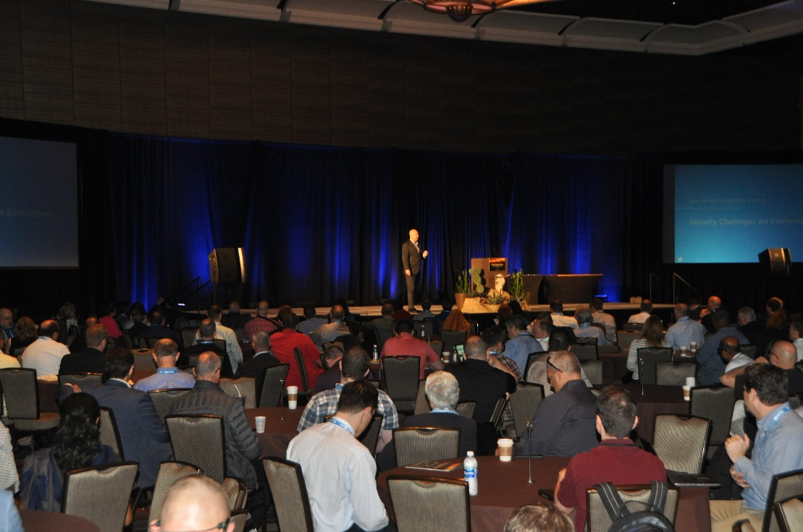
About the Conference
High level Keynote presentations
Relevant educational sessions on cutting edge topics and tracks
Up to 16 CPE credits

Slide 9

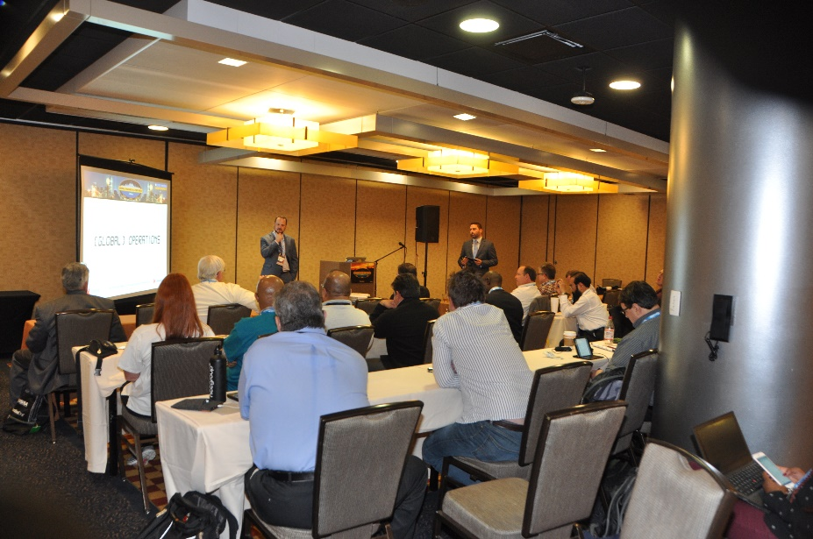
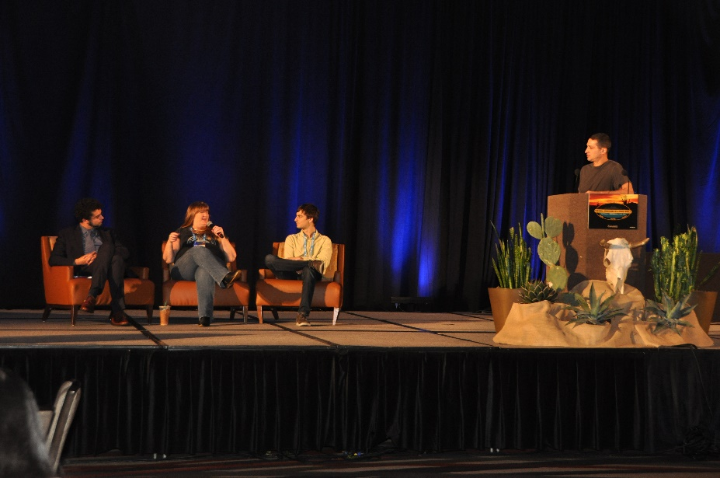
Special Presentations
  Cyber Defense Center
  ISSA Special Interest Group (SIG) sessions
  Featured Speakers

Slide 10
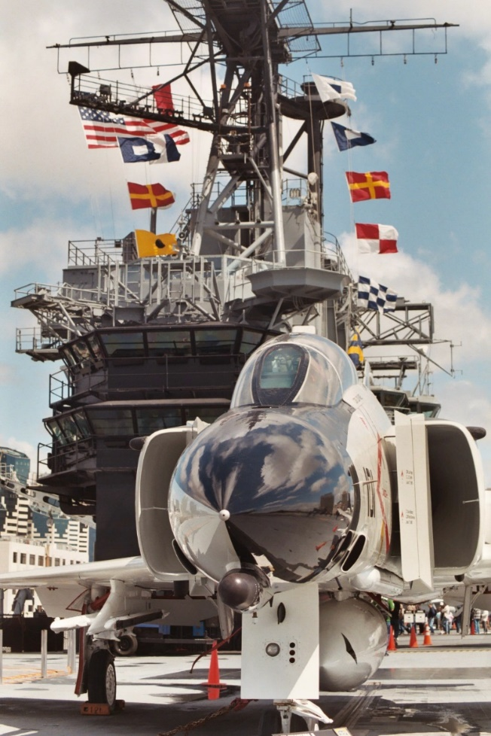
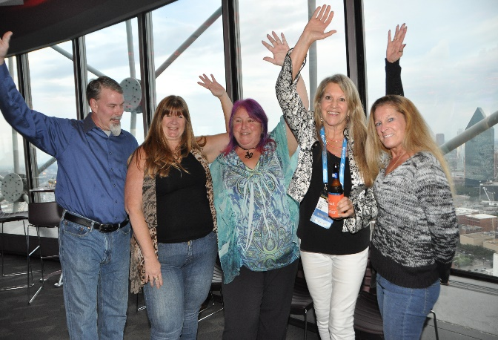
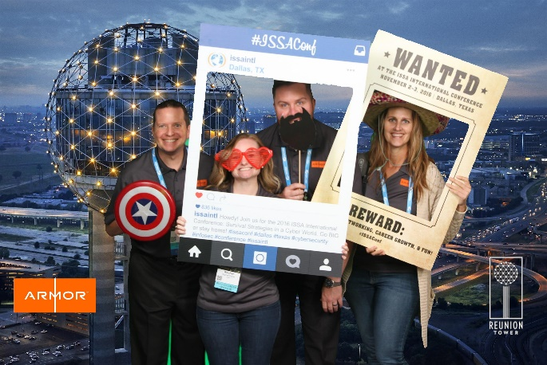
Receptions and Networking
ISSA Exhibitors Reception and Capture the Flag
3rd Annual Party in the Sky
on the USS Midway
Career Center and more!

Slide 11
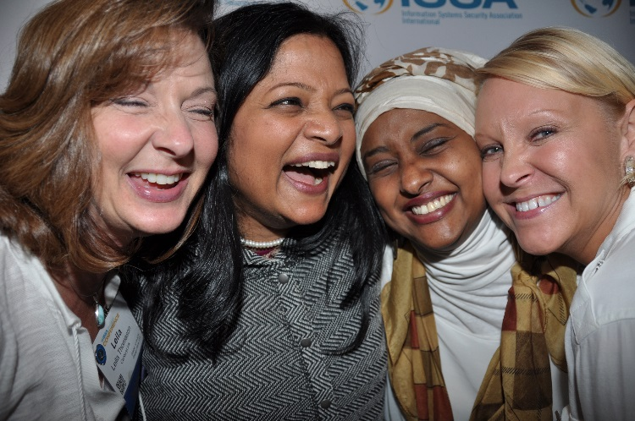
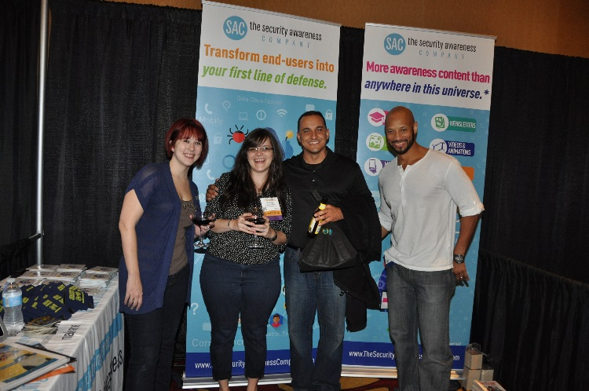
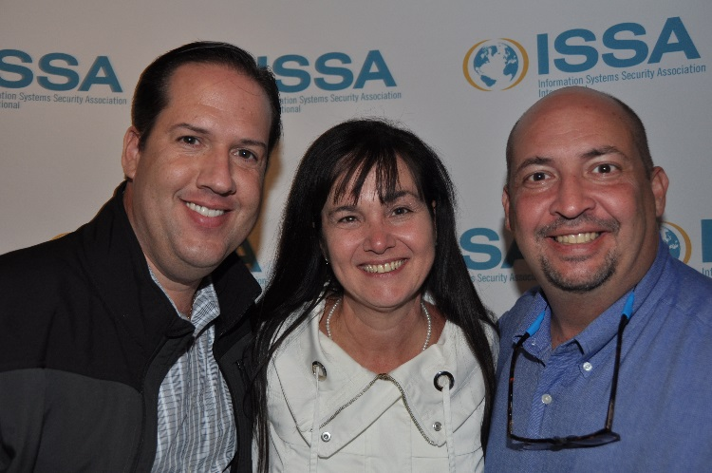
Conference details and registration information will be available online at:
https://www.issa.org/page/issaconf_home
For more information, contact
Leah Lewis: llewis@issa.org

Slide 12
ISSA PHX IS A HOST CHAPTER
20% off code: 20PHO17

Slide 13

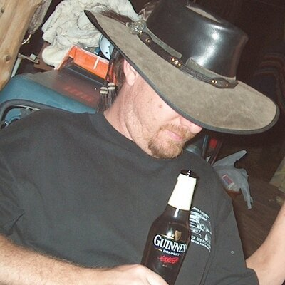
Rich Larkins Memorial Scholarship
Two trips to San Diego for the ISSA International Conference
Travel
Lodging
Conference admission
Drawing at the end of the meeting today!

Slide 14
Q4 MEETING MOVED TO
TUESDAY, DECEMBER 5

Slide 15

September 7, 2017
Desert Willow Conference Center
phxsac.com

Slide 16
AZCWR
As for chapter business. .. just mention that the AZCWR is growing and we will be at PHXSAC with more details.
Rich Larkins
2017

