Slide 1
Common Threat Traits for
Effective Strategy Development
Bob Hansmann
Director, Security Technologies

Slide 2

PEOPLE ARE THE CONSTANT IN SECURITY
TECHNOLOGIES CHANGE
Notes:
Let’s focus on the one constant in the noise: people. First, your company’s sensitive data and IP must always be protected. How does it get lost or stolen? It simply starts with people who may lose the data accidently, maliciously, or through compromise.
-- reserve the spectrum

Slide 3
UNDERSTANDING USER INTENT
ACCIDENTAL INSIDER
COMPROMISED INSIDER
MALIIOUS INSIDER
Inadvertent Behaviors
Poorly communicated policies and user awareness
Broken Business Process
Data where it shouldn’t be, not where it should be
Malware
Infections
Phishing targets, breaches, BYOD contamination
Stolen
Credentials
Credential exfiltration, social engineering, device control hygiene
Rogue
Employee
Leaving the company, poor performance review
Criminal Actor
Employees
Corporate espionage, national espionage, organized crime
Notes:
Let’s focus on the one constant in the noise: people. First, your company’s sensitive data and IP must always be protected. How does it get lost or stolen? It simply starts with people who may lose the data accidently, maliciously, or through compromise.
-- reserve the spectrum

Slide 4

PROTECTING
THE HUMAN POINT
Where critical data and IP are most valuable – and most vulnerable
Notes:
Jim: Protecting against ransomware and other attacks like Petya is one of the reasons we created Forcepoint. We’re taking a different approach to security, focusing on understanding cyber behaviors and users’ intent at the point where people and data come together – what we call The Human Point.
With that, we’d like to open it up to questions.

Slide 5

An Unbalanced Landscape
50 billion endpoints
Internet of Things
10 billion endpoints
2020
2005
2010
2015
2020
1 billion endpoints
2015
2005
2010
Security Talent Pool
Notes:
Part of this is due to the rapidly changing technology landscape.
<click>
The number of endpoints we need to manage has exploded from only 1 billion in 2005 to an estimated 50 billion in 2020 driven by innovations such as BYOD, Cloud applications, and the Internet of things.
<click>
Unfortunately, we have not seen a corresponding growth in the pool of available, experienced security personnel to help us deal with this challenge.
<click>
As a result, our teams are being drowned in alerts and investigation demands as the shortage not only impedes our ability to defend our organizations, but our ability to respond to attacks and investigate potential breaches.

Slide 6
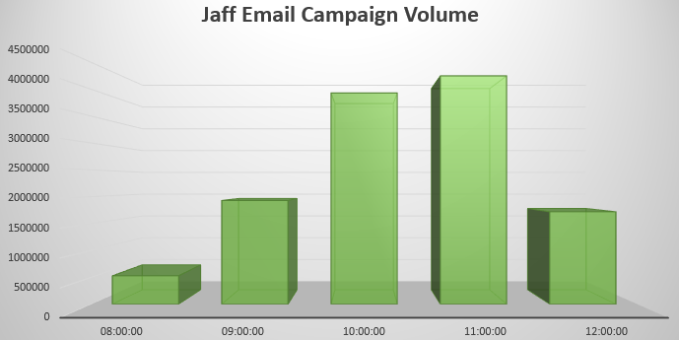
Modern Threats are Fast!

Slide 7
Modern Threats are Fast!
Spam & Phishing Defenses
Phishing Education
Adv. Zero-Day
Malware Detection

Slide 8
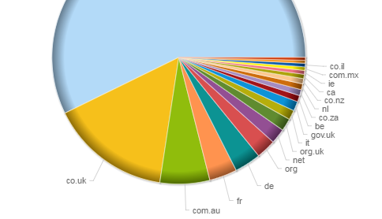
… and global
Notes:
https://blogs.forcepoint.com/security-labs/jaff-enters-ransomware-scene-locky-style

Slide 9
Case Studies & Trends
WannaCry
Petya
Researcher Predictions
Notes:
Ransomware/Malware and BCDR: Ransomware is one of the principal weapons used to attack financial institutions.
Discover the latest developments and key methods of defense.

Slide 10
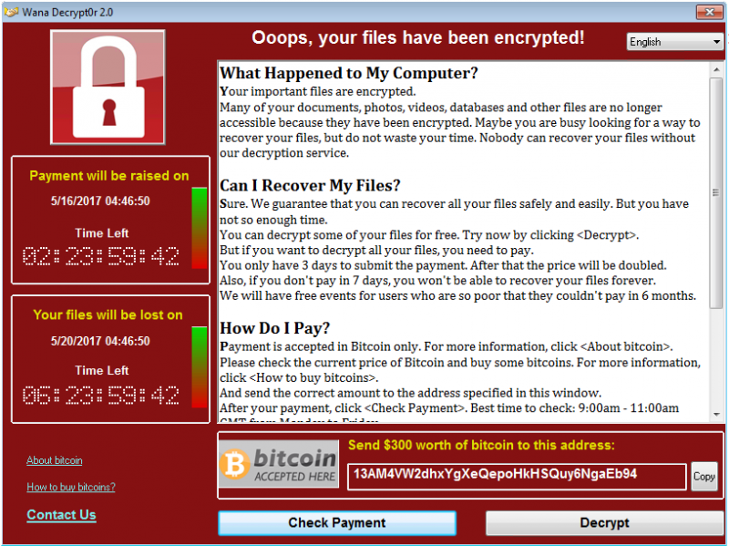
Notes:
https://blogs.forcepoint.com/security-labs/wannacry-ransomware-worm-targets-unpatched-systems

Slide 11
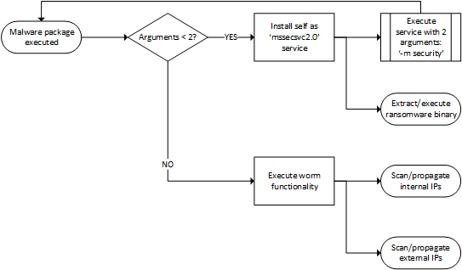
Lateral Movement is vital to attackers success
Notes:
https://blogs.forcepoint.com/security-labs/wannacry-post-outbreak-analysis

Slide 12
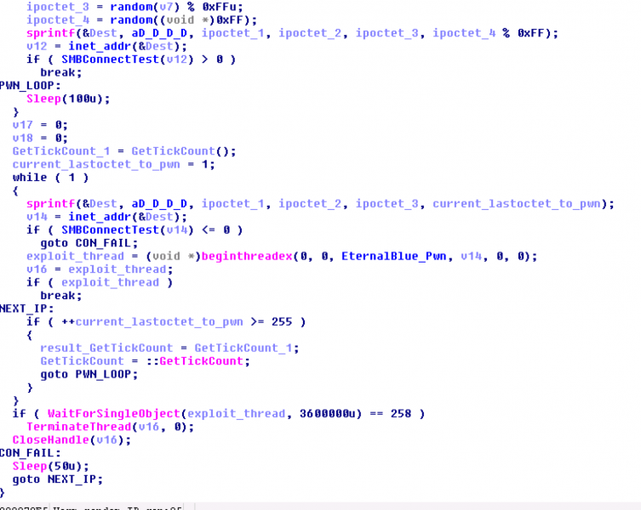
Notes:
https://blogs.forcepoint.com/security-labs/wannacry-ransomware-worm-targets-unpatched-systems

Slide 13
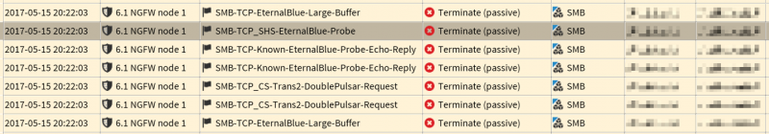
Notes:
https://blogs.forcepoint.com/security-labs/wannacry-post-outbreak-analysis

Slide 14
What’s in a name?
Petya
NotPetya
PetrWrap
GoldenEye
Expetr
Notes:
Jim: Petya first arrived on the scene last year, but this most recent variation is different.
Cliff: [talk about what was seen last year] That’s prompted some organizations to refer to it by a different name. Since it’s common for malicious code attacks to change regularly, we and most other security organizations have taken to referring to it as Petya since that’s where it comes from.

Slide 15


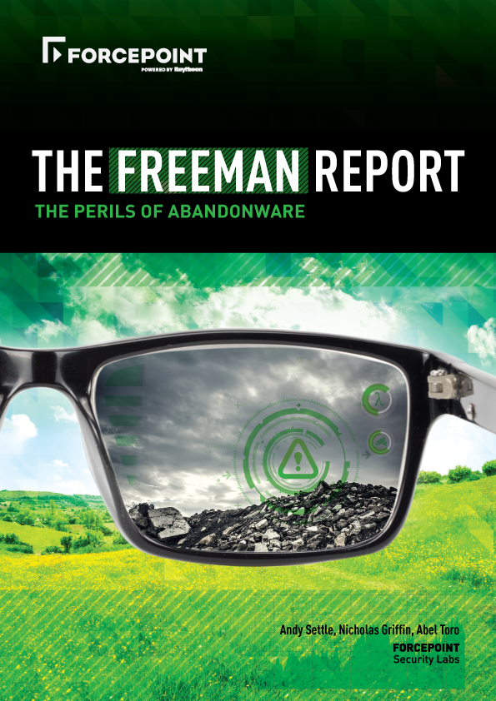
How Does Petya Spread?
From Ukraine via product update
Uses the same SMBv1 vulnerability that WannaCry used – but only for moving internally
Harvesting admin credentials for use with PSEXEC and WMIC
NOT seeing Petya use vulnerabilities to move externally
Potentially exploiting trusted relationships to spread externally
Forcepoint Labs warned of this type of attack happening back in 2016
Notes:
Cliff: So, how does Petya spread? This is one of the ways in which Petya is notably different from WannaCry. While it does us the same vulnerability in SMB for moving internally within an organization’s network, it also harvests admin credentials for using PSEXEC and WMIC.
Researchers have not yet seen it use the SMB vulnerability to attack other organizations over the Internet. Which leads to the interesting question: how is it getting to other networks? [Partner/supplier trust relationships, etc.]

Slide 16
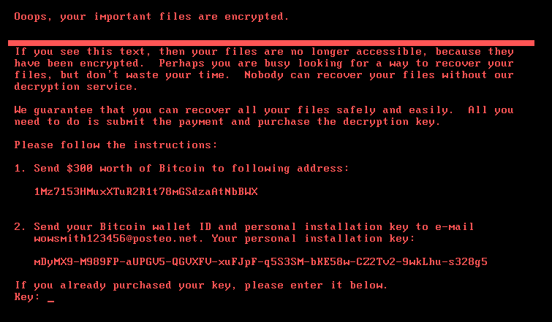
Notes:
Jim: Petya has made headlines as the latest in a string of ransomware attacks, but it has some peculiarities that make it stand out. We’ll look at those and talk about steps you can take to be prepared for the next attack.

Slide 17
How is Petya more dangerous than WannaCry?
Doesn’t just encrypt individual files, modifies the Master Boot Record
  Potentially renders the whole disk unusable
  Shreds the MBR under certain conditions – such as when it finds Kaspersky AV on the machine
Grabs admin credentials for spreading locally through PSEXEC and WMIC protocols
Has a built-in delay
Doesn’t have a global kill switch
Petya
WannaCry
Notes:
Jim: Petya has some similarities to WannaCry, but also some important differences. In some ways, it’s actually nastier than WannaCry. For example,
Doesn’t just encrypt individual files, modifies the Master Boot Record, potentially rendering the whole disk unusable
Grabs admin credentials for spreading locally through PSEXEC and WMIC protocols
Has a built-in delay Doesn’t have a global kill switch, making it hard for researchers to turn it off centrally
Cliff, what are some of the implications of these?
Cliff: First, it’s interesting that it only damages the MBR under certain conditions, which are themselves quite interesting. It only does this if it finds Kaspersky AV on the machine.
Second, it focuses a lot of effort on harvesting administrator credentials and uses those to spread laterally over PSEXEC and WMIC [give examples].
It tries to escape immediate notice by delaying its activities, likely to maximize its chances of propagation.
And, unlike WannaCry, the lack of a master kill switch prevents researchers from turning it off. Although, there are reports that creating a dummy file with a specific filename in the \Windows directory may thwart some variants of Petya.

Slide 18
How is Petya less dangerous than WannaCry?
Geographically concentrated in Ukraine
Encrypts a smaller number of file extensions
(still hits the ones you care about)
Has not been observed to aggressively spread over the Internet
WannaCry
Petya
Notes:
Jim: Looking at the flip side, Petya is more limited in scope than WannaCry
It started in Ukraine and most of the damage seems to have been done there, although organizations in other countries getting hit as well. It encrypts a smaller number of file extensions – not that it really matters since it hits all the major ones you care about. And, this one we’ve mentioned: it doesn’t have WannaCry’s aggressive attempts to randomly try different network addresses.
Cliff, what should people make of this?
Cliff: Petya has hit far fewer machines than WannaCry, but it’s still very dangerous. [It has taken significant portions of shipping companies and other organizations offline.]

Slide 19
What are 8 best practices to follow
Carefully vet any 3rd parties who deliver software updates into your environment
Know where your data resides
Patch, patch, patch
Backup, backup, backup your files
Limit privileges and admin access
(even on laptops)
User Education – keep teaching in different ways
Control or eliminate outdated and otherwise vulnerable technologies
(SMBv1, abandonware, Java, etc.)
Use multiple layers of defense
Consistent, coordinated Malware protection across key vectors
(NGFW, web, email)
Improve cloud app visibility and control (CASB)
Revisit IPS/IDS for Internal network segmentation/monitoring
UEBA for highly critical or sensitive users/systems
Outbound defences to contain threats
(DLP & UEBA)
Notes:
Jim: What are best practices to follow to protect against future attacks
Jim: Don’t even try pay the ransom – Petya’s been disabled anyway
Cliff: Carefully vet any 3rd parties who deliver software updates into your environment
Jim: Patch, patch, patch – especially the SMBv1 vulnerability from March of this year, you don’t want the 3rd time to be the charm
Cliff: Backup, backup, backup your files
Jim: Consider disabling SMBv1 – Forcepoint customers see our KB at https://support.forcepoint.com/KBArticle?id=000012832
Cliff: Limit admin access (principle of “least privilege”), even on laptops
Jim: Use multiple layers of defense – around and within your network
Network Firewalls and internal IPS
Cyber behavior monitoring (including data monitoring)
(Cliff: Monitoring is a big issue. Where do businesses get the time and the staff to do this? AV/IPS/SIEM/etc. consoles are all well and good but there needs to be the staff available to monitor the alerts. The bigger the business the more resource is necessary. This is where automation and a focus on understanding behaviors and intent is crucial).
Malware protection across communication channels (web, email, major apps, etc.) (Malware protection in general is still a must)
Control use of unsanctioned cloud apps that could introduce malicious code into your environment – CASB can help

Slide 20

What you should do to protect your organization?
keep up with patches
More than just
a good idea…
Think Audit Compliance
a human-centric approach
multi-layered defense
Notes:
Jim: What can we learn from Petya? More to the point, what are some of the ways that you could reduce the risk that your network could get affected by this or a subsequent attack?
As everybody keeps remaindering people: keep up with patches for your operating system and core applications
Patches for the SMB vulnerability have been available for a long time, but clearly a lot of people are still vulnerable (Eternal vulns were patched March).
Start taking a human-centric approach to securing your environment
The point where people and data intersect is where information is most valuable – and most vulnerable
Understanding user intent is key to discerning among different types of cyber behaviors
Use a multi-layered defense
Internet-facing firewalls (like Forcepoint’s) have been protecting against exploits such as the SMB one used, for years
Segment your internal network – at least use IPS capabilities between portions of your network if not outright access limitations
Note: not just a good idea, it’s the law! Growing compliance mandates (including GDPR) mandate protection
Cliff: That’s right. The implications from GDPR, for example, are quite significant. And not just for European companies. (What are the ramifications for businesses who get compromised in a way that leads to a global incident. How do we feel about negligence as a crime and what should be the punishments? Company that spread NotPetya could face charges of criminal negligence)

Slide 21

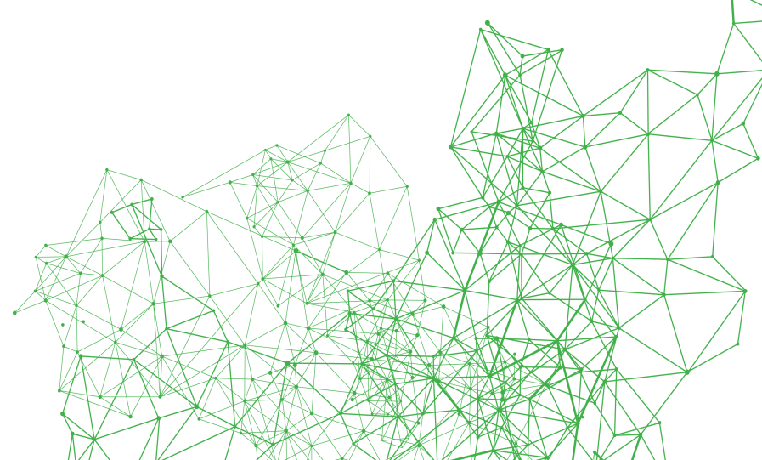
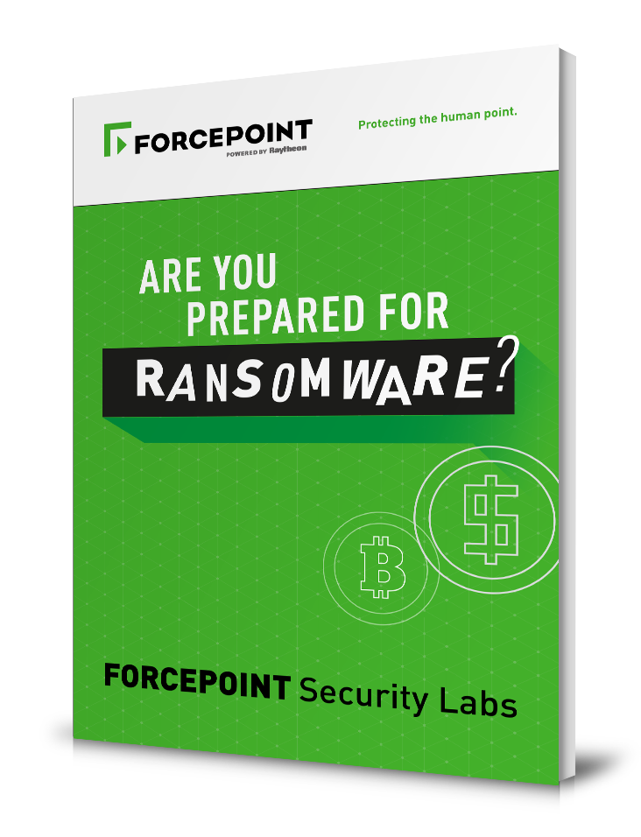
where IS
ransomware headed?
Expect to see ransomware keep growing
Expect to see self-propagation techniques continue to draw on best techniques developed by silent theft-focused attacks
Key an eye out for attacks focused on cloud-based data
www.forcepoint.com/RANSOMWARE
Notes:
Cliff: Petya is just one of an ongoing series of attacks. Sadly, we should all expect to see a lot more coming our way.
Expect to see ransomware keep growing
Expect to see self-propagation techniques continue to draw on best techniques developed by silent theft-focused attacks (agree this could well be the next trend)
Key an eye out for attacks focused on cloud-based data
Learn more at forcepoint.com/RANSOMWARE (ad)
And, always, at blogs.forcepoint.com

Slide 22
QUESTIONS

Slide 23
THANK YOU

